Slide 1
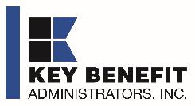
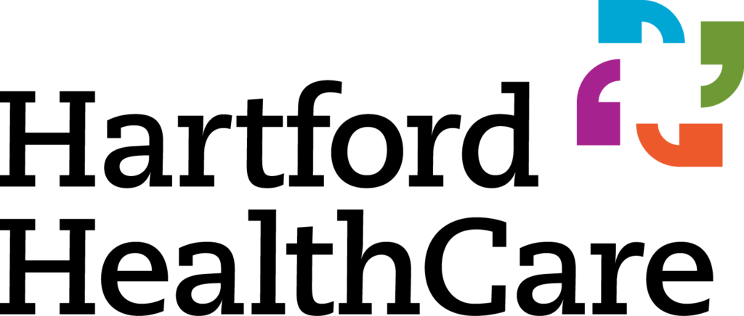


HARTFORD HEALTHCARE DIRECT-TO-EMPLOYER ASSESSMENT
OCTOBER 8, 2024

Slide 2



Founded in 1979 and headquartered in Indianapolis, IN​
Full-service TPA specializing in the administration of self-funded health plans and population health management​
One of the country’s largest independently-owned TPAs
The Key Family is a commonly-held group of benefits related organizations with:​
3,000+ corporate clients​
3.0 million members under management​
700 Employees
Exclusive Relationships
We know The Market – Agents, Networks, and MGAs

Slide 3


Market Leader in Private Labeled DTE Plans
Louisville, KY
OneHealth Plan
Cincinnati, OH
TCH Optimal
Bentonville, AR
Northwest Health Plan
Knoxville, TN
East Tennessee Health Plan
Meridian, MS
Affinity Health Plan
Fort Myers, FL
Lee Health Care Partners

Slide 4
Direct-to-Employer Strategy: Only Available to Premier Health Systems
STRONG Brand Quality
EXTENSIVE Patient Access
AFFORDABLE Value Pricing
EXCELLENT Care Quality

Slide 5
Hartford HealthCare is Patient Recommended
Health System | HCAHPS Recommendation Percentile | CMS Stars Percentile | Mortality Percentile | Readmission Percentile | KBA Brand Quality Score
Stamford Health | 73 | 87 | 69 | 66 | 70
Other Independent Hospitals | 56 | 61 | 68 | 56 | 64
Northwell Health | 46 | 64 | 76 | 59 | 62
Yale New Haven Health System | 45 | 76 | 65 | 67 | 61
Hartford HealthCare | 41 | 74 | 74 | 60 | 59
Prospect Medical Holdings | 28 | 61 | 69 | 68 | 54
Trinity Health | 21 | 47 | 65 | 73 | 51
KBA assesses HCAHPs recommendation rates and other quality data to determine if the DTE health system can support a narrow network plan.
Based on current data, KBA believes Hartford Healthcare will need to partner with another local system to be successful.
These models are based on an assumption of including a partner health system.

Slide 6
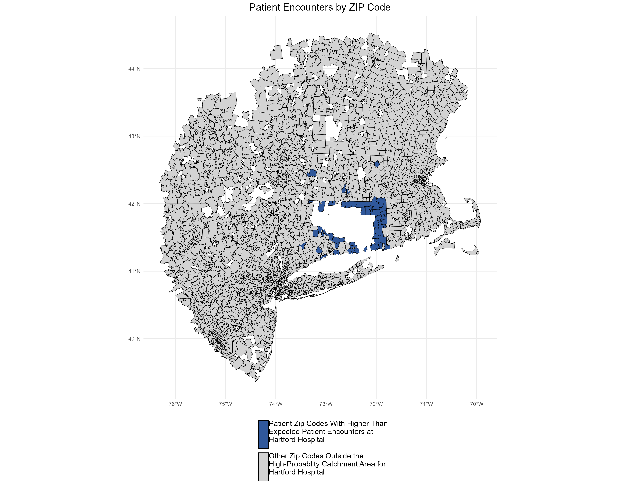
An Indicator of Brand Quality
KBA models Medicare patient encounter data to identify strong health system brands where patients will travel past other hospitals or long distances to frequent a specific hospital.
The center of the donut are zip codes within which patients have a higher probability of frequenting Hartford Hospital. These zip codes are ignored for this analysis.
Significant patient encounters outside of this center, as seen here, indicate that patients are willing to travel significant distances, passing other hospitals to go to Hartford Hospital.
This data might indicate that the HCAHPs brand data is a false indicator of brand weakness.

Slide 7
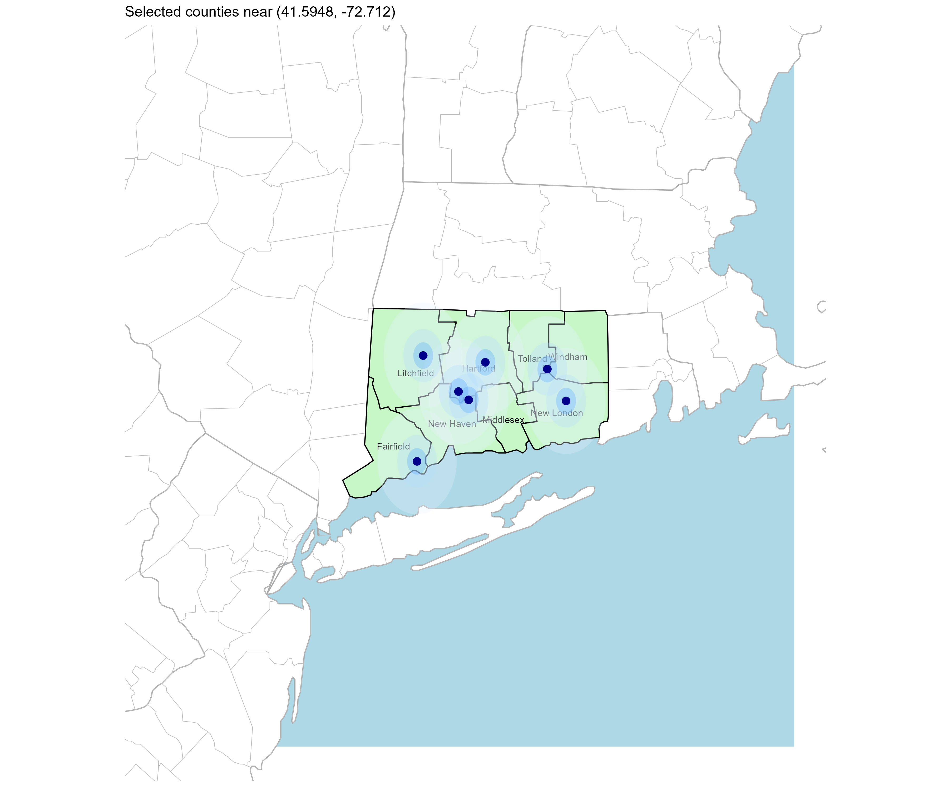
Significant Opportunity for Plan Growth Researched for the State of Connecticut
Target Market 5,000+ Employers 1,100K+ Employees 2,300K+ Members
 | Employer Size Group (# of Employees)
Commercial Employers With Headquarters | 50-100 | 101-200 | 201-400 | 401-1,000 | 1,001-3,000 | 3,000+
In Catchment Area | 3,024 | 1,224 | 725 | 422 | 147 | 122
Total Employees at Employers | 50-100 | 101-200 | 201-400 | 401-1,000 | 1,001-3,000 | 3,000+
Headquartered in Catchment Area | 226,800 | 183,600 | 217,500 | 295,400 | 294,000 | 1,342,000
Total Members with Employers | 50-100 | 101-200 | 201-400 | 401-1,000 | 1,001-3,000 | 3,000+
Headquartered in Catchment Area | 408,240 | 330,480 | 391,500 | 531,720 | 529,200 | 2,415,600

Slide 8
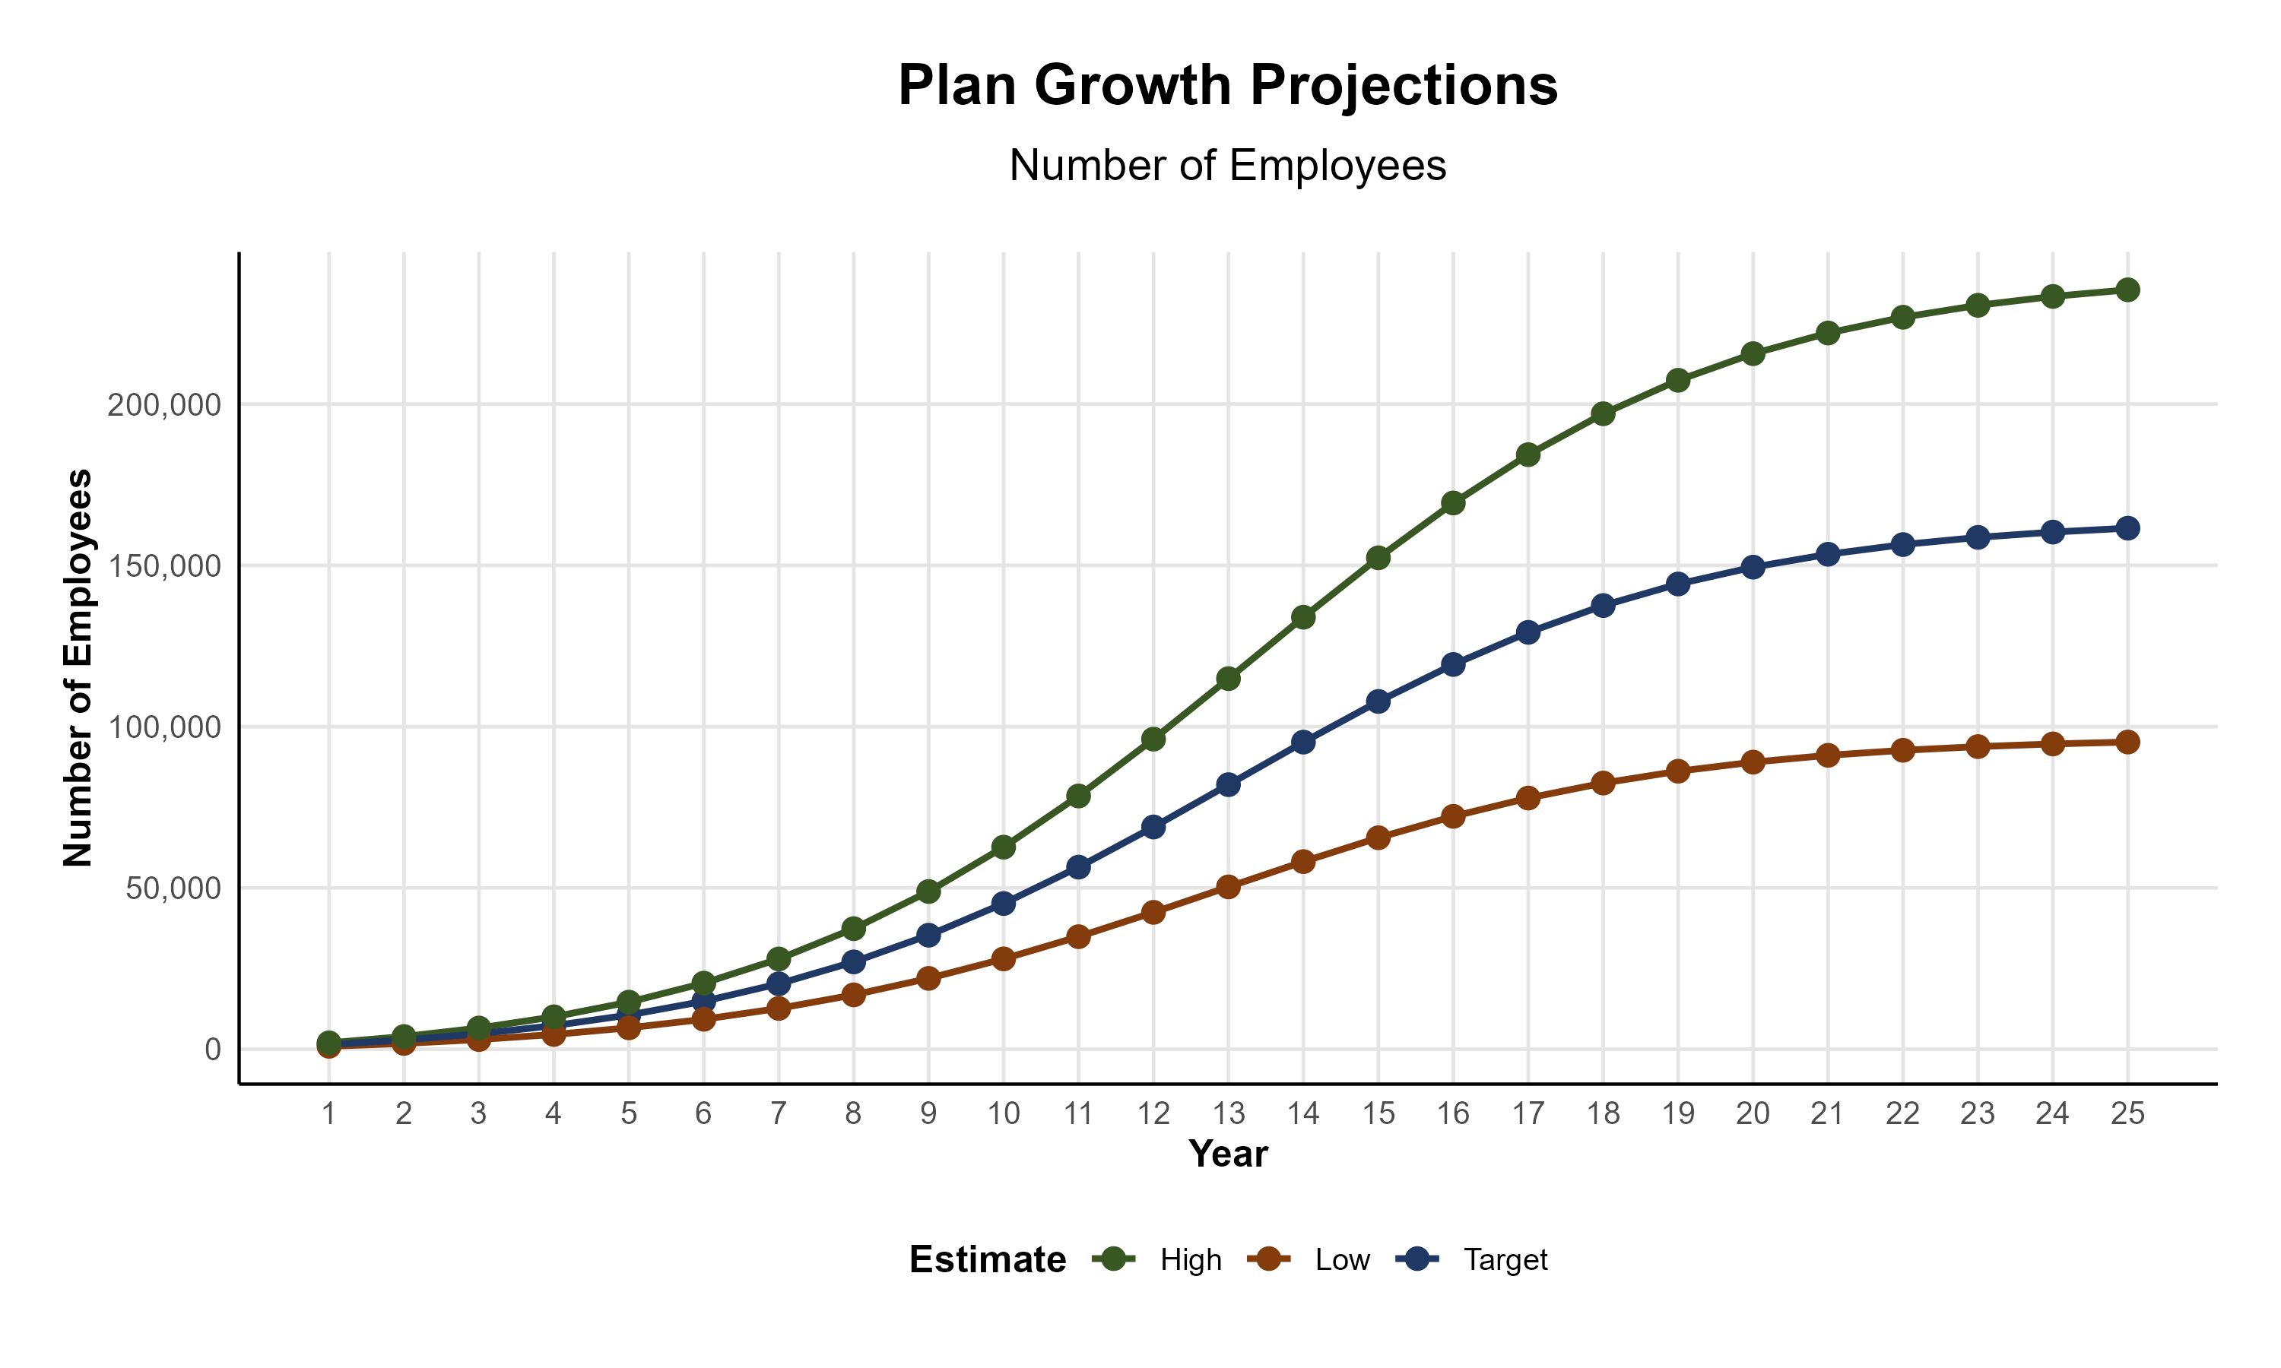
Plan Potential Growth Paths
Self Funded
1,071K
PLAN GROWTH POTENTIAL
1,556K
Insured
Working Age
2,162K
Population
3,611K
Estimates includes all of the State of Connecticut.

Slide 9

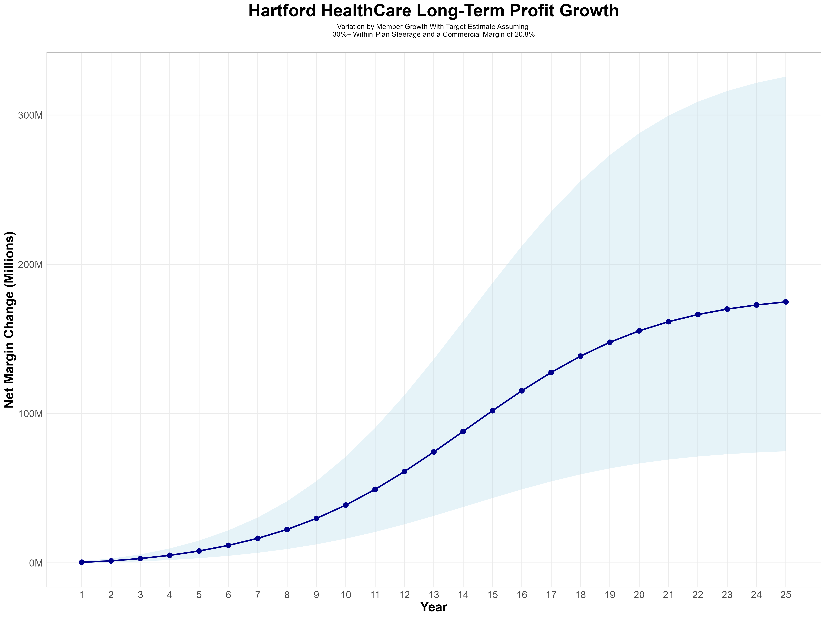
Growing Powerful, Lasting Profitability
Early Stage
Gaining Name Recognition, Early Growth
New Revenue:
New Profit:
$40.69M
$8.53M
Growth Stage
Strong Reputation, Strong Growth
New Revenue:
New Profit:
$327.7M
$69.81M
Mature Stage
High Profitability, Market Saturation
New Revenue:
New Profit:
$739.32M
$157.2M

Slide 10
Year 4 Projected Revenue and Profit
Pre-DTE Cohort of 13,100 Employees | Inpatient | Outpatient | Professional | Total
Revenue† | $ 12,498,665 | $ 9,225,464 | $ 4,308,213 | $ 26,032,341
Net Income‡ | $ 2,599,722 | $ 1,918,896 | $ 896,108.3 | $ 5,414,727
† Assuming proportional revenues from market shares of 30% (inpatient) and 12% (outpatient)
‡ Conservatively assuming a commercial margin of 20.8% (80% of the estimated commercial margin)
With DTE | Inpatient | Outpatient | Professional | Total
Revenue⁰ | $ 22,082,047 | $ 32,534,153 | $ 15,193,173 | $ 69,809,372
Net Income* | $ 4,593,066 | $ 6,767,104 | $ 3,160,180 | $ 14,520,349
⁰ Assuming 53% inpatient and 43% market steerage based on KBA narrow network DTE experience (see previous slide)
* Conservatively assuming a commercial margin of 20.8%, with a 10 percentage-point reduction to reflect competitive-edge rates and a 10 percentage-point increase to reflect lower billing costs and better patient-responsibility collections because of the plan patient card.
Total Increase in Net Income | $ 9,105,622
Network Access Fee (Revenue) of $1 PMPM | $ 157,200
Total Profit Growth | $ 9,110,422
Minus Implementation Fee (One-Time) | -$ 0
Minus Sales and Marketing (Annual – Ongoing) | -$ 180,000
Total | $ 9,082,822

Slide 11





A Partner You Can Trust
OUR OBJECTIVES ARE ALIGNED
WE KNOW THE
MARKET
COMPLETELY TRANSPARENT
WE HAVE THE SOPHISTICATION AND INFRASTRUCTURE TO EFFECTIVELY COMPETE
Derek Moore, Senior Vice President – KBA
845-283-9973 * derek.moore@keybenefit.com

